Slide 1


STUDENT FINANCE OVERVIEW
UNDERSTAND WHAT IT MEANS TO YOU

Slide 2
STUDENT FINANCE OVERVIEW
PRESENTATION CONTENTS
This presentation will provide you with the fundamental messages needed to understand student finance:
Section 1 – What support can you get?
Section 2 – How do you get it?
Section 3 – When and how do you repay it?
Section 4 – Budgeting and Key Messages
i
If you usually live in Wales, Northern Ireland or Scotland, then the student
finance administration you apply to and the funding available can differ
Notes:
https://www.studentfinancewales.co.uk/
https://www.studentfinanceni.co.uk/
https://www.saas.gov.uk/

Slide 3

STUDENT FINANCE ENGLAND
AN INTRODUCTION
Student Finance England provide financial support on behalf of the UK government
to eligible students from England entering higher education in the UK:
Two main costs you will have while studying are:
  tuition fees, and
  living costs
SFE make funding available to help students with both.
You may be able to get a range of financial help and support, depending on;
Your course and where you live and study
Your household income
Your personal circumstances
i
Figures in these slides are for academic year (AY) 2025/26 and subject
to change in future years based on government policy

Slide 4
STUDENT FINANCE ENGLAND
GENERAL ENTITLEMENT
i
Generally, a Tuition Fee Loan is available for your first full undergraduate course,
plus one extra year should you need it:
This extra year could be used if you choose a course but realise it is not for
you and want to start a different one, or if you need to repeat a year of study
You might not get full support if you have to repeat more than one year or have any previous HE study, but personal circumstances can be taken into account
+
=
26/27
27/28
28/29
Extra
Year
4 years support
Example based on standard 3-year Full-Time Degree
i
Go to www.gov.uk/student-finance/who-qualifies for more information
Notes:
Full Time Students
If you have previously studied and gained a Equivalent or Lower Qualification (ELQ), you will be unable to get full support, irrespective of whether you received funding from SLC or not. You will not be eligible for Maintenance Loans, Tuition Fee support or Maintenance Grants but will be eligible to receive Grants for Dependants' and DSA support.
A few things to remember:-
If you study a higher level qualification, you will be eligible to apply for full funding.
Previous study that did not lead to a qualification will not be counted if entirely self funded at a private institution.*
If you have not received funding from student finance but did get NHS funding (e.g. NHS Bursary), this will be counted when calculating your entitlement.
*Any other previous study will be counted and taken into consideration when calculating any funding for your new course.
If you have not attained a ELQ then you may still be eligible for a non-means tested ML.
Part Time Students
Part time students are eligible to receive up to 16 years worth of finance from Student Finance England. Students who previously studied part time and did not receive funding from Student Finance England (self funded) will still have this counted as previous study - providing the previous course was an eligible course.

Slide 5
STUDENT FINANCE OVERVIEW
WHAT SUPPORT COULD YOU GET?
ACADEMIC YEAR 2025/26

Slide 6

STUDENT FINANCE 2024/25
THE STUDENT FINANCE PACKAGE – TUITION FEE LOAN
MAINTENANCE
LOAN
#2
APPLY
TUITION FEE
LOAN
EXTRA
SUPPORT
#1

Slide 7
STUDENT FINANCE 2025/26
TUITION FEES AND LOANS
For academic year 2025/26, Approved (Fee Cap) Higher Education providers can
charge full-time undergraduate students tuition fees of up to £9,535:
With tuition fees of up to £9,535, can you afford to study in higher education?
Eligible students won’t have to pay any tuition fees up front
A Tuition Fee Loan is available to cover the fee charged by a provider
A Tuition Fee Loan doesn’t depend on household income
SFE pay a Tuition Fee Loan directly to your university or college
i
Other course and study options that also attract student financial support
include Accelerated Degrees and part-time undergraduate qualifications
Notes:
Maximum fees for full-time and part-time undergraduate courses will remain at 2021/22 levels in 2022/23.
The maximum fee for standard full-time courses offered by Approved (Fee Cap) Providers with an Access and Participation Plan (APP) and a Teaching Excellence and Student Outcomes Award (TEF) will remain at £9,250 in 2022/23.
The maximum fee for full-time accelerated degree courses offered by Approved (Fee Cap) Providers with an APP and a TEF will remain at £11,100 in 2022/23.
The maximum fee for part-time courses offered by Approved (Fee Cap) Providers with an APP and a TEF will remain at £6,935 in 2022/23.
Lower maximum fees will remain at 2021/22 levels in 2022/23 for (i) courses offered by providers without an APP and/or a TEF (ii) years of study under the Turing Scheme (iii) overseas study years (iv) work placement years and short final years of full-time courses.
Students undertaking courses at Approved (Fee Cap) Providers will be able to apply for up-front tuition fee loans to meet the full costs of their tuition. Maximum fees for undergraduate courses offered by Approved Providers are not capped.
Students undertaking courses at Approved Providers will be able to apply for up-front tuition fee loans towards the costs of their tuition which will remain at 2021/22 levels in 2022/23: up to £6,165 for a standard full-time course; up to £7,400 for a full-time accelerated degree course and up to £4,625 for a part-time course.

Slide 8
STUDENT FINANCE 2025/26
THE STUDENT FINANCE PACKAGE – MAINTENANCE LOAN
MAINTENANCE
LOAN
EXTRA
SUPPORT
TUITION FEE
LOAN
#1

Slide 9
STUDENT FINANCE 2025/26
MAINTENANCE (LIVING COST) LOANS
So that’s tuition fee’s covered, but what other support can you get?
A Maintenance Loan is available to help students with their living costs:
All eligible students are entitled to get some Maintenance Loan support
The actual amount you can get depends on your household income and where you live and study
Your Maintenance Loan is paid directly into your bank account each term
Tuition Fee and Maintenance Loans do have to be repaid but not until you’ve left university/college and your income is over the relevant threshold
i
If your household income is under £25,000 then you can apply for the full
rate of Maintenance Loan

Slide 10

STUDENT FINANCE 2025/26
FULL-TIME SFE MAXIMUM MAINTENANCE LOAN RATES
Full-Time students, not eligible for benefits or aged over 60
£
£8,877
Parental Home Rate:
Live at home while they study
£
Elsewhere Rate:
Live and study away from home, outside London
£10,544
£
London Rate:
Live and study away from home, in London
£13,762
i
Different rates of Maintenance Loan are available to full-time students who
are entitled to benefits or aged over 60 before the first day of their course
Notes:
Household Income Assessment
The income assessment for full year and final year rates of loans for living costs is calculated as follows:
Parental Home Rate: £1 reduction in loan for every complete £7.27 increase in income above £25,000.
London Rate: £1 reduction in loan for every complete £7.08 increase in income above £25,000.
Elsewhere Rate: £1 reduction in loan for every complete £7.20 increase in income above £25,000.
Overseas Rate: £1 reduction in loan for every complete £7.13 increase in income above £25,000.
The income threshold for the minimum non-income assessed full rate of overseas loan is: £65,941

Slide 11
STUDENT FINANCE 2025/26
FULL-TIME SFE MAINTENANCE LOAN RATES
Full Year Student | Maximum Loan | Non-Income Assessed | Income Assessed
Parental Home | £8,171 | £3,597 | £4,574
Elsewhere | £10,544 | £4,915 | £5,629
London | £12,667 | £6,308 | £6,359
Overseas | £11,116 | £5,374 | £5,742
i
The Overseas rate is available for students on an approved study year
abroad as part of their UK based course
Notes:
Household Income Assessment
The income assessment for full year and final year rates of loans for living costs is calculated as follows:
Parental Home Rate: £1 reduction in loan for every complete £7.27 increase in income above £25,000.
London Rate: £1 reduction in loan for every complete £7.08 increase in income above £25,000.
Elsewhere Rate: £1 reduction in loan for every complete £7.20 increase in income above £25,000.
Overseas Rate: £1 reduction in loan for every complete £7.13 increase in income above £25,000.
The income threshold for the minimum non-income assessed full rate of overseas loan is: £65,941

Slide 12
STUDENT FINANCE 2025/2026
MAINTENANCE LOAN - MEANS TESTING
For the higher rate of Maintenance Loan, you will need to give SFE details of your
household income:
Household income is the income of any parents, stepparent, parent’s partner,
wife, husband, civil partner or partner you usually live with
When the household income reaches a certain level, students are only entitled to receive the non-income assessed rate of Maintenance Loan
For AY 2022/23 this was £62,311 for the ‘Elsewhere’ rate of loan, £70,022 for the ‘London’ rate and £58,253 for the ‘Parental Home’ rate
If your household income is over a certain level (£42,875) then an ‘assessed contribution’ amount is included in the Maintenance Loan calculation process
i
Assessed contribution is the government estimate, based on household
income of the financial support parents/partners can provide a student
Notes:
Depending on their income, parents may have to contribute towards your living costs while you're studying.
If you’re a dependent student, the income of your parents will be assessed. If your parents are separated or divorced, we’ll use the income of whichever parent you’re financially dependent on, including the income of your parent's partner, if they have one.
This means we will not need income details from the parent that you're not dependent on, or have less contact with.
We’ll work out your parents’ residual income (which includes the income of your parent’s partner, if they have one) by taking their gross income
(before tax and National Insurance) and taking off allowances for the following:
• payments into private pension schemes, additional voluntary contributions and employment related costs
• £1,130 for any child other than you who is totally or mainly financially dependent on them
• £1,130 if your parent is also a student
Once we’ve taken off the relevant amounts and worked out your parents’ residual income, we add this to your income and do a full income assessment

Slide 13

STUDENT FINANCE 2025/26
FULL-TIME SFE MAINTENANCE LOAN ENTITLEMENT
Household Income | Home | Elsewhere | London
£25,000 & under | £8,171 | £10,554 | £12,667
£35,000 | £6,796 | £8,318 | £11,255
£45,000 | £5,420 | £6,929 | £9,843
£55,000 | £4,045 | £5,540 | £8,430
£65,000 | £3,597 | £4,915 | £7,018
£75,000 | £3,597 | £4,915 | £6,308
i
You can get an estimate of your loan entitlement using the calculator on:
www.gov.uk/student-finance-calculator
Notes:
Household Income Assessment
The income assessment for full year and final year rates of loans for living costs is calculated as follows:
Parental Home Rate: £1 reduction in loan for every complete £7.27 increase in income above £25,000.
London Rate: £1 reduction in loan for every complete £7.08 increase in income above £25,000.
Elsewhere Rate: £1 reduction in loan for every complete £7.20 increase in income above £25,000.
Overseas Rate: £1 reduction in loan for every complete £7.13 increase in income above £25,000.
The income threshold for the minimum non-income assessed full rate of overseas loan is: £65,941

Slide 14
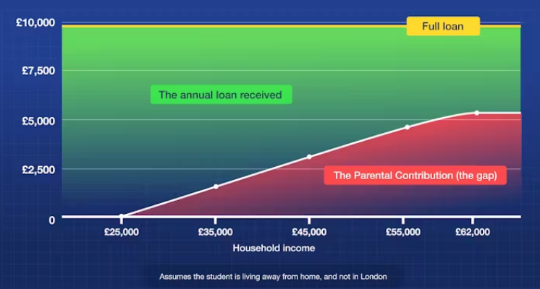

Slide 15
STUDENT FINANCE 2025/2026
THE STUDENT FINANCE PACKAGE – EXTRA SUPPORT
MAINTENANCE
LOAN
EXTRA
SUPPORT
#2
APPLY
TUITION FEE
LOAN
#1

Slide 16
STUDENT FINANCE 2025/2026
SOURCES OF EXTRA SUPPORT FOR STUDENTS
ADDITIONAL SUPPORT
There may also be extra financial support available for students who;
Have a disability, long-term health condition, mental health condition or specific learning difficulty
Have children or adult dependants
Study overseas as part of their UK based course or go on a clinical placement
Study eligible Nursing, Midwifery or Allied Health Profession courses
For more details on this support go to www.gov.uk/student-finance/extra-help and www.nhsbsa.nhs.uk/student-services
Many universities and colleges offer bursaries and scholarships, which can depend on things like academic results, course choice or household income
Notes:
Childcare Grant
Helps with childcare costs for dependent children aged under 15 at the beginning of the academic year (or under 17 if they have special educational needs) in registered or approved childcare. For more details on what childcare qualifies, visit www.gov.uk/studentfinance
Depending on their household income, the student can apply for 85% of their actual childcare. They can get this money for term times and holidays. Students won’t qualify for this grant if they, or their husband, wife or partner get the childcare part of the Working Tax Credit or childcare element of Universal Credit from HM Revenue & Customs.
Parents’ Learning Allowance
This allowance can help with course-related costs for students with dependent children.
The amount they can get depends on their household income; that is the income of the student’s husband, wife or partner (if they have one) and that of any dependants.
Adult Dependants’ Grant
The grant can help if a student has an adult who depends on them financially. This can’t be the student’s grown-up child or other adult who gets student finance.
There are some exceptions to eligible ‘other adult dependants’; students can’t claim for a spouse, civil partner or co-habiting partner who is also a student receiving a statutory award.
Disabled Students’ Allowances (DSAs) help pay for extra costs a student might have as a direct result of their disability, long-term health condition, mental-health condition or specific learning difficulty such as dyslexia or dyspraxia. DSAs are additional support available to students who may otherwise be prevented from attending a higher-education course because of a disability.
Key facts about DSAs:
• Available to undergraduates and postgraduates studying full-time or part-time
• Doesn’t have to be repaid
• Doesn’t depend on household income: the amount students can get relates to their needs up to specified maximum amounts
• Doesn’t affect benefit entitlement. For example, other help students might get, like Disability Living Allowance, won’t be affected by DSAs
• Isn’t affected by a student’s age
• Isn’t affected by previous study
• Is paid directly to the supplier of the service or (in some circumstances) into the student’s bank account
Who can get DSAs?
DSAs are available to those who have:
• a mental-health condition, such as anxiety or depression;
• a specific learning difficulty, such as dyslexia or dyspraxia;
• a developmental disorder, such as autism or ADHD/ADD;
• a progressive medical condition such as Multiple Sclerosis, cancer or HIV;
• a sensory impairment which could affect the ability to see or hear;
• another physical or medical condition; or
• a long-term health condition.
Other conditions not mentioned on this list may be covered by DSAs
The applications for dependants grants and DSA can be triggered through the main student finance application process!!

Slide 17
STUDENT FINANCE OVERVIEW
APPLICATIONS

Slide 18
STUDENT FINANCE APPLICATIONS
THREE STAGE PROCESS
SFE ASSESS
YOUR
APPLICATION
#2
APPLY
YOU GET
PAID!
YOU APPLY
ONLINE
#1

Slide 19
STUDENT FINANCE APPLICATIONS
KEY MESSAGES
Each year, too many students apply late for their finance and could have no way to
pay for courses or accommodation at the start of term...don’t let that be you!
Tips to help make sure your student finance gets paid on time;
You don’t need a confirmed place at university or college to apply
Apply with your preferred choice, you can change the details later if necessary
Make sure any evidence and information needed to support your application
is supplied ‘right first time’ both from you and your parents (or partner)
Read, understand and agree to the loan Terms and Conditions
i
The full-time SFE application service usually opens in the Spring with a
late May deadline: Go to studentfinance.campaign.gov.uk for details
Notes:
Other notes of importance for students;
Make a note of your account log-in details and keep them safe
Agree to share information from your application, this helps apply for many bursaries and some scholarships
Make sure any evidence and information needed to support your application is supplied first time (yours and your parent/partners’)
Submit your application even if there is a delay in getting income details from your parent/sponsor so some funding (Tuition and Maintenance Loan) will be available when you start your course
If SFE ask you to send any additional evidence or documents to support your application use recorded delivery!
Before starting the application, students should have the following to hand:
• Passport - SLC can check identity using valid UK passport details for most students
• University and course details – Remember apply with your first choice initially so your application can be assessed as soon as possible
• Bank account details
• National Insurance number
• Parent’s or partner’s National Insurance number and income details

Slide 20
STUDENT FINANCE APPLICATIONS
COMPLETING AN APPLICATION
Before starting an application, students should have the following to hand:
• Passport, Birth Certificate or other identity and residency evidence information, which can include valid EUSS Share Codes for EU, EEA and Swiss nationals
• University and course details
UK bank account details and National Insurance number
The easiest way for parents or other sponsors to support an application is also
online through GOV.UK, providing their information including:
• National Insurance numbers and income information (based on prior tax year)
Details of other child dependants
i
If their household income decreases by at least 15%, students can be
reassessed: www.gov.uk/support-child-or-partners-student-finance-application
Notes:
The easiest way for a student to prove their identity is to give us their valid UK passport number online, when they apply. We can then check and confirm their identity without them having to actually send us their passport. If a student doesn’t have a valid UK passport they’ll need to send us their original *birth or *adoption certificate, along with a Birth/Adoption Certificate Declaration Form.
This is available from www.gov.uk
If the student is a non-UK passport holder, they’ll need to send us their *valid non-UK passport and any original *supporting letters from the UK Border Agency explaining the student’s residency status. *These must be original documents, not photocopies. We’ll return them once we’ve confirmed their identity and checked they’re eligible.
If there is more than one dependant child in the same household, a standard allowance of £1,130 is deducted from the household income for each of these additional dependants. If there is more than one student from the same household in higher education (depending on household income) a further reduction may be possible through applying split contributions (expected parental contribution to a students maintenance costs)
For example, in a household with two students and a household contribution of £500, this would be divided between the two students. Where students in the same household fall under different student finance regulations, their household contribution would be calculated according to the regulations which apply to their individual circumstances. The household contribution is then divided by the number of students in that household.
A full chart of expected contributions based on household income can be found on in the policy documents on practitioners.slc.co.uk.

Slide 21
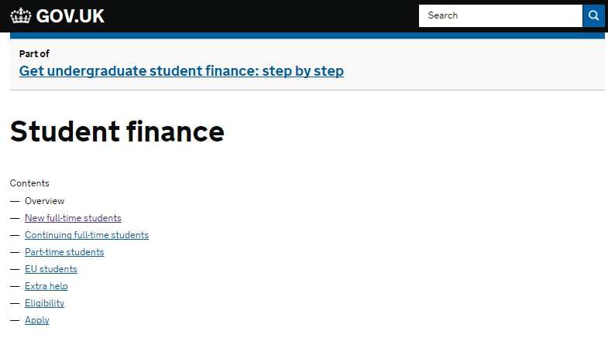






STUDENT FINANCE APPLICATIONS
GOV.UK/STUDENTFINANCE AND SFE ONLINE
More information about student finance can be found on GOV.UK and across the
SFE social media channels:
www.thestudentroom.co.uk/studentfinance
www.facebook.com/SFEngland
www.twitter.com/SF_England
www.ucas.com/sfe
www.youtube.com/SFEFILM

Slide 22
STUDENT FINANCE OVERVIEW
REPAYMENT

Slide 23
STUDENT LOAN REPAYMENT
THREE THINGS TO KNOW
THE
FIGURES
#2
APPLY
THE
INTEREST
THE
FACTS
#1

Slide 24
STUDENT LOAN REPAYMENT
POST-2024/25 INCOME CONTINGENT PLAN OVERVIEW
From academic year 2024/25, loan repayment policies for undergraduate students
in England will be changing and key facts about how repayments will work include;
You won’t have to make repayments until your income is over a set threshold, which is currently £25,000 a year until April 2027
From April 2027 the threshold is set to rise annually with inflation (RPI)
If you study a full-time course, you will be due to start repaying from the April
after completing your course or leaving/withdrawing from higher education
If your income drops below the threshold, your repayments will stop and any outstanding balance will be written off 40 years after entering repayment
Information: educationhub.blog.gov.uk/2022/02/24/get-the-facts-about-student-loan-reform
Notes:
https://educationhub.blog.gov.uk/2022/02/24/get-the-facts-about-student-loan-reform/
New borrowers commencing study from academic year 2023-24 onwards
There will be a new loan plan type for students who start courses from academic year 2023/24. The new loans will have:
o In-and-post-study interest rates of RPI+0%.
o A repayment threshold of £25,000, maintained at this level up to and including financial year 2026-27, and uprated by inflation (RPI) from April 2027 onwards.
o A repayment term length of 40 years.
Key messages
The new loan plan does ask graduates to repay for longer and from an income threshold of £25,000, but it also increases certainty for borrowers by reducing interest rates to match inflation only.
This ensures that, under these new terms, borrowers will not have to repay more than they have borrowed in real terms.
A student who completes their degree in summer 2026 with a loan on the new terms, and who commences a job with a salary of £28,000 a year, would expect to repay around £17 per month towards the cost of their higher education over financial year 2027-28.
Compared with borrowers on Plan 2 loan terms, borrowers with a loan on the new terms will repay – at most – up to £30 per month more in financial year 2027-28.
The Government will be keeping these new loan terms under review.

Slide 25
STUDENT LOAN REPAYMENT
POST-2024/25 STUDENT LOANS – THE INTEREST
Interest on a student loan will start being added as soon as the first payments are
released:
For students starting courses from academic year 2025/26, interest rates will be RPI +0% - this means the value of the loan in real terms does not change
RPI is Retail Prices Index and the rate applied for student loans is set annually
Repayments are calculated at 9% of all income above the £25,000 threshold
Student borrowed £20,000
Graduate earns £30,000
Income eligible for repayment calculation = £5000
Repayment rate = 9%
Annual repayment = £450
Monthly repayment = £37.50
Student borrowed £30,000
Student borrowed £50,000
Student borrowed £40,000
See www.gov.uk/repaying-your-student-loan for more information
Notes:
New borrowers commencing study from academic year 2023-24 onwards
There will be a new loan plan type for students who start courses from academic year 2023/24. The new loans will have:
o In-and-post-study interest rates of RPI+0%.
o A repayment threshold of £25,000, maintained at this level up to and including financial year 2026-27, and uprated by inflation (RPI) from April 2027 onwards.
o A repayment term length of 40 years.
Key messages
The new loan plan does ask graduates to repay for longer and from an income threshold of £25,000, but it also increases certainty for borrowers by reducing interest rates to match inflation only.
This ensures that, under these new terms, borrowers will not have to repay more than they have borrowed in real terms.
A student who completes their degree in summer 2026 with a loan on the new terms, and who commences a job with a salary of £28,000 a year, would expect to repay around £17 per month towards the cost of their higher education over financial year 2027-28.
Compared with borrowers on Plan 2 loan terms, borrowers with a loan on the new terms will repay – at most – up to £30 per month more in financial year 2027-28.
The Government will be keeping these new loan terms under review.

Slide 26
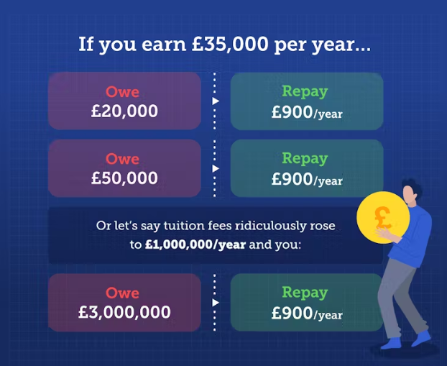

Slide 27
Example calculations
Student borrowed £50,000
Graduate earns £30,000
Income eligible for repayment calculation = £5000
Repayment rate = 9%
Annual repayment = £450
Monthly repayment = £37.50
Initial loan written off after 40 years*
Student borrowed £50,000
Graduate earns £50,000
Income eligible for repayment calculation = £25000
Repayment rate = 9%
Annual repayment = £2250
Monthly repayment = £187.50
Initial loan repaid after 22 years
Student borrowed £50,000
Graduate earns £100,000
Income eligible for repayment calculation = £75000
Repayment rate = 9%
Annual repayment = £6750
Monthly repayment = £562.50
Initial loan repaid after 8 years
*Total amount paid = £18000

Slide 28
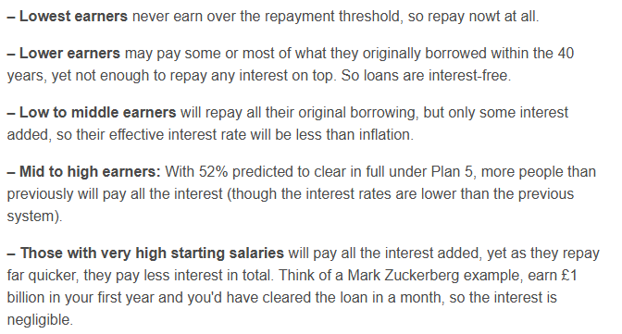

Slide 29
