Slide 2
20 Top Tips

Slide 3
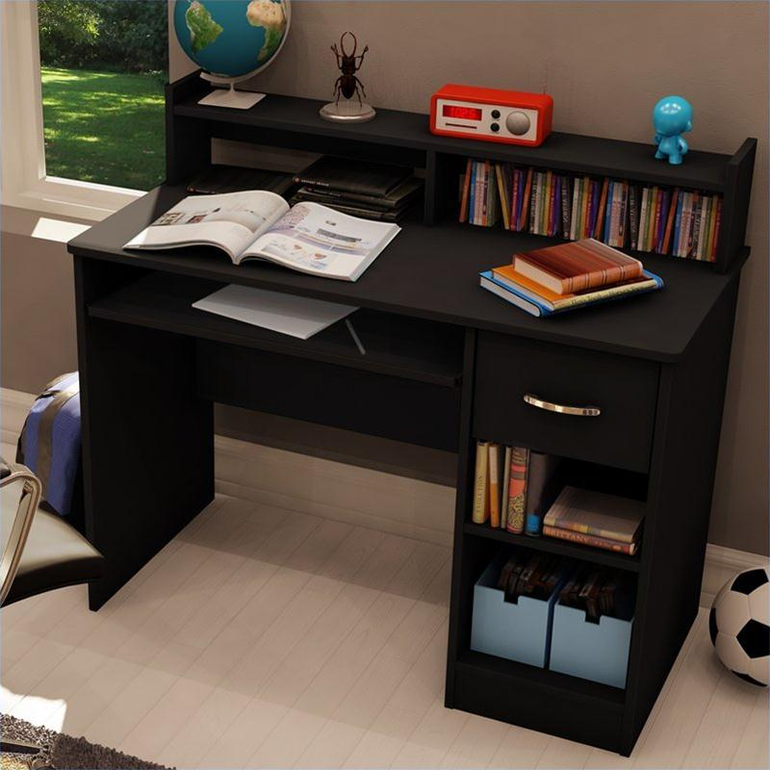
Have a clear space to work at home
Away from distractions!
Plenty of Space

Slide 4
Have resources to hand
Highlighters, paper, pens, pencils, ruler etc.
Revision Guides
Correct exam board
Ask for recommendation from teacher (or available tonight)

Slide 5
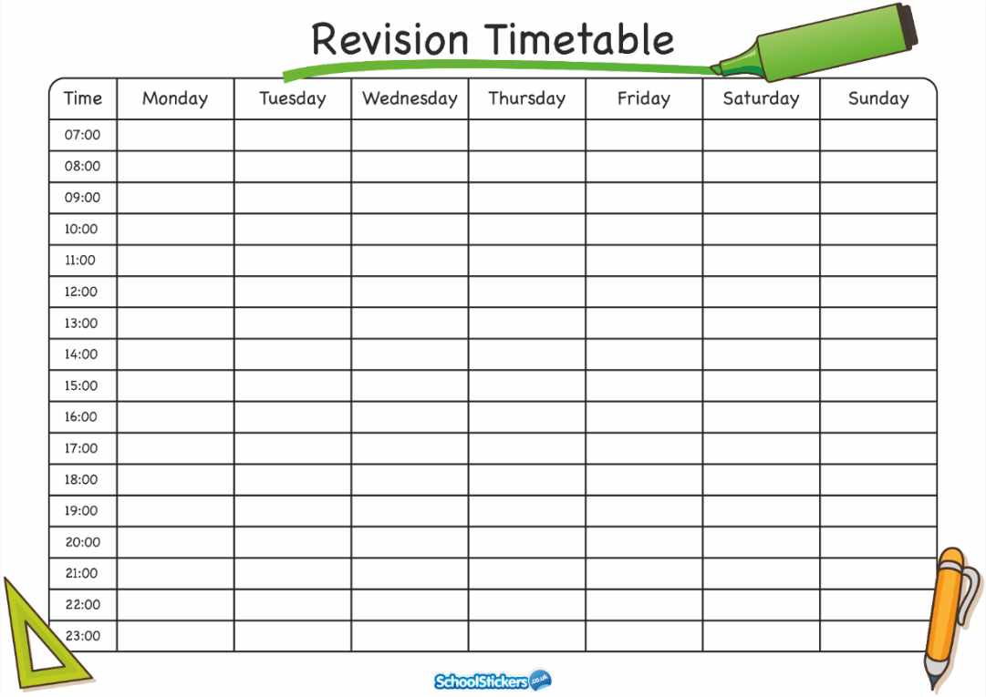
Create a revision timetable together
Write on a wall planner or use ‘www. GetRevising.co.uk’
Can add dates of exams/CA deadlines etc
Time limit (not task limit) on things from to-do list: BUT a specific objective to each revision period
Break tasks down to be manageable (this is a new skill for many students, independence)
Could be done now, with long term and short term plans on

Slide 6
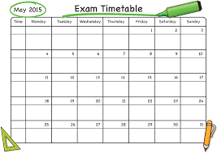
Make your own copy of their exam timetable.

Slide 7
Ask them how you can help

Slide 8
Establish a routine
Set time to work each evening, even now
Can be used for homework initially, but a good habit to start with
If they have 'no homework' (unlikely, check SMHW) then can start making revision resources, even now (mocks, useful for final exams too)
Bedtime/getting up

Slide 9
Agree 'check in' times to discuss where they are up to with the targeted work
Reduces 'nagging' feeling and potential arguments?

Slide 10
Work-life balance
General wellbeing
Sleep
Breakfast
Priorities
Flexibility and negotiation if something ‘comes up’

Slide 11
Organisation
Everything in the same place (links to workspace)
Empty bag at the end of the day
File any handouts or work?
If they’ve lost something important, sort it now

Slide 12
Removing distractions
Music - not in exam, definitely not TV
Take them tea/biscuit rather than them stopping and leaving the workspace (unless it is a timetabled break)

Slide 13
Showing an interest
What have you done today?
Know their timetable? Have it handy? (on the fridge?)
Have a list of questions to ask?
'nothing' is not ok

Slide 14
Communication with school
Email teachers if concerned? (most likely to get a quicker response as we’re teaching) Try to contact with plenty of time
SMHW- don't just believe that they’ve not got any or that they've done it.
Period 6 - keep timetable handy so know when sessions are on, don’t plan anything for those evenings

Slide 15
Use interim reports to help focus revision/independent work
Subjects that are well below target should be focus to start with
Read the descriptors of each to establish what can be done to improve.

Slide 16
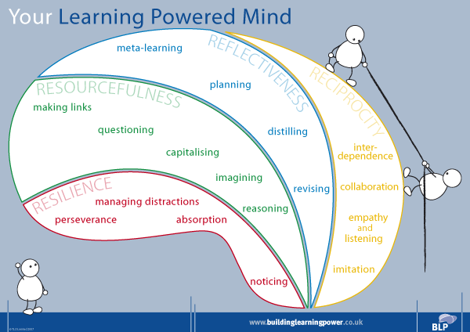
Language used
Growth mind-set – not a case of permanence
- Trying, challenge, takes time and effort
The power of yet
- I don’t understand this, yet
Discussing problems
- Specific, temporary, solvable

Slide 17
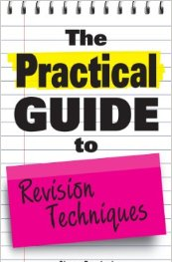
Practical revision:
Test with flashcards/questions that they have made
Mind maps
Post-it notes
Watch the revision techniques video for more practical suggestions
Notes:
Take this out??

Slide 18
Know the specification and exam board of subjects
Past papers – access online
Structure of exam papers/CA outline
Go through this when they get their exam timetable too!
Specifications will tell you everything that they need to know – access online

Slide 19
Encourage them to teach you.
Will show their true understanding of topics
Good for motivation

Slide 20
Ask them questions using
exam-style language.
Rather than just asking what they have revised, try asking them to…
Identify
Explain
Describe
Analyse
Etc.

Slide 21
Be positive!

Slide 22
Reward high quality revision and effort

Slide 23
Teacher emails -
Command words – print out cards + example Qs - BENN
How to access specs + -
Send email for each subjects – exam board, POSTER
Make A5 checklist

